Slide 1
Kashmiri Culture
Presented by:
Hamza Shahid (20P-0117)
Hassaan Anwar(22P-9160)
Inayat Ullah(20P-0487)

Slide 2
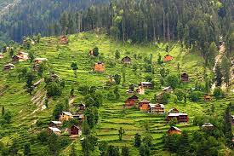
Kashmir
Northern Pakistan
Immense Natural Beauty
Lush Green Valley
Inspiration For Artists

Slide 3
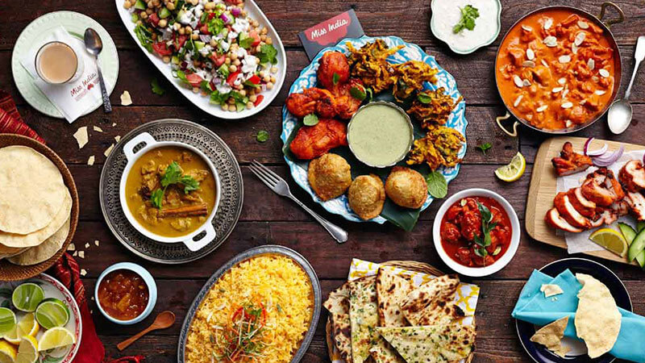
Cuisines
Vegetarian:
Hak
Rajma
Tursh
Shree Pulao
Nadeir Yakhaen
Ladyar Tsaman

Slide 4
Cuisines
Non-vegetarian:
Kashmiri Kebab
Rogan Josh
Pasanda
Syun Alu
Methi Keema

Slide 5
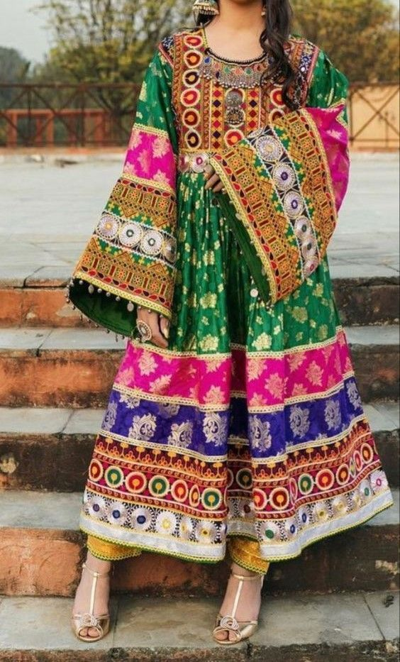
Costumes
Women Use:
Nose And Ear Rings
Bangles
Necklaces
Lose Salwar Kameez

Slide 6
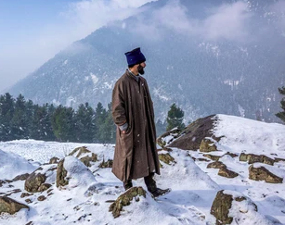
Costumes
Men Use:
Kurta
Pajama, Salwar
Gurabi
Skullcaps
Pheran (Overcoat)

Slide 7
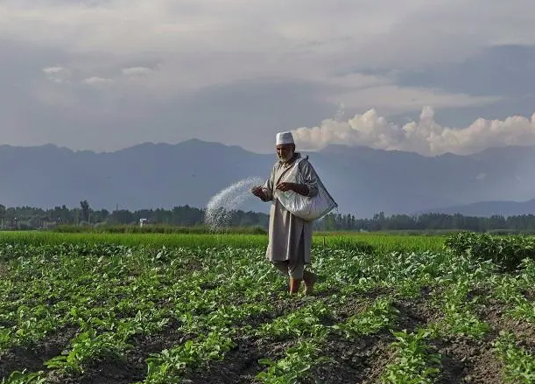
Occupation
Agriculture
Rice
Maize
Mustard
Cotton Seeds
Linseed
Lotus-Stalk

Slide 8
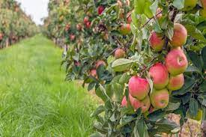
Occupation
Fruits:
Grapes
Apples
Cherries
Walnuts
Almonds

Slide 9
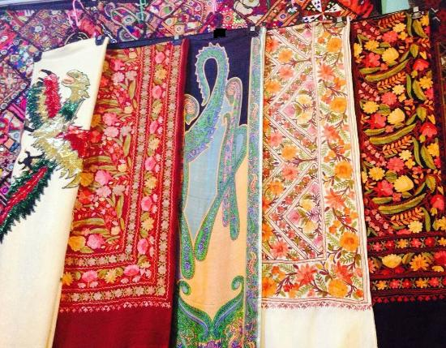
Handicrafts
Pashmina Shawl (famous)
Hand-Knotted Carpets
Woolen Rugs

